Slide 1
EE 538 - Computing Principles for Electrical Engineers
Trojan Map Spring 2022
Instructor: Arash Saifhashemi
Presented By: Rudrax Dave

Slide 2
Description of the Project
Implementing various graph algorithms to build a map application using different data structures in C++.
Trace the shortest path between two points, also implementing the Travelling Trojan Problem.
Using and Implementing this with help of Different Algorithms and understanding how they work.
Using OpenCV to visualise the Map.
Utilizing Google Tests for unit testing with Bazel Server.
Creating a Dynamically, Animated UI for the project.

Slide 3
Project Steps
Implemented using these Steps- Functions:
Autocomplete the location name
Find the place's Coordinates and Check the Distance between
Calculate Shortest Path between two places
The Travelling Trojan Problem (AKA Travelling Salesman!)
Cycle Detection
Topological Sort
Find Nearby
Comparison Between Runtimes of Separate Algorithms
Creation of the Animated & dynamic User Interface

Slide 4
Some Major Algorithms Implemented and Learnt
Dijkstra algorithm
Bellman-Ford algorithm
Brute-force (i.e. generating all permutations, and returning the minimum)
Brute-force enhanced with early backtracking
2-opt Heuristic & 3-opt (Tried)
Topological Sort

Slide 5
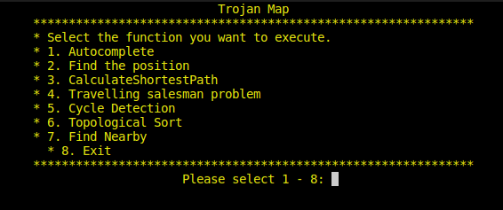
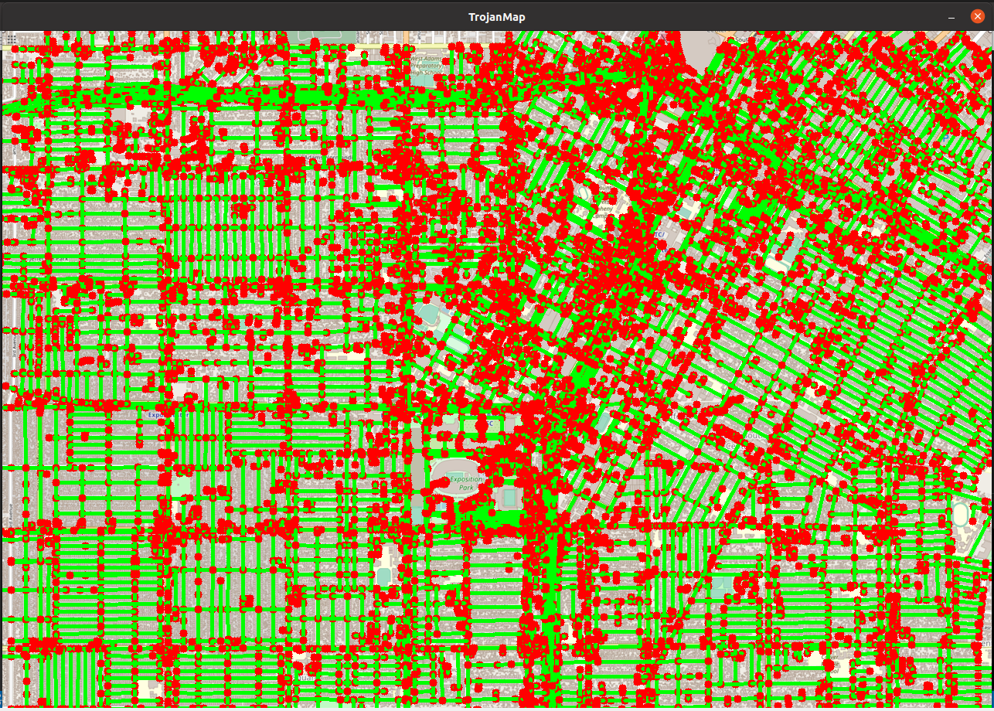
UI Interface and How it Works:
The First UI which Pops Up in the Terminal when the program is executed
Fig 2. Trojan Map Application
Fig 1. Trojan Map UI
This is the given MAP- Which we have to use for our functions and get required outputs.
We have to select the Number from 1 – 8 for the execution of desired functions

Slide 6
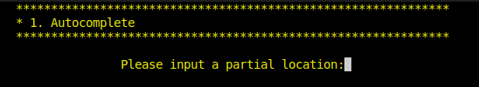
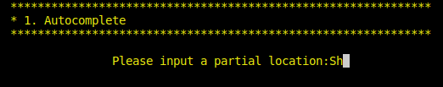
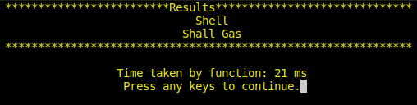
Implementing Step 1:Autocomplete
Auto-Complete the Location Name(AutoComplete Function)
Returns a list of possible locations based on the input if given a partial name, as prefix.
The function is case insensitive.
Time Complexity: O(n) We check if Nodes’ names contains search string as it’s prefix. In case it contains, we add this name to the result list.
Eg.: Sh -> Shell, Shall Gas
Fig 3. Autocomplete Function Example

Slide 7
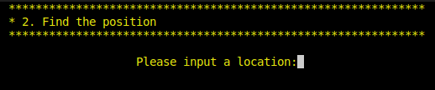
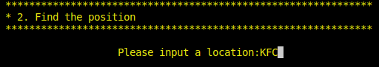
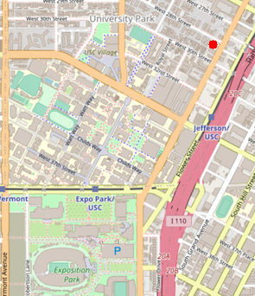
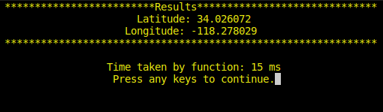
Implementing Step 2_1:GetPosition
Find Location Coordinates in Map (GetPosition Function)
Gives the Latitude and Longitude of the input location
Implemented getter functions to get Latitude, Longitude of the node and utilised them to get a position for the given node.
KFC
Fig 4. GetPosition Function Example
Case sensitive & Plots with Red Dot on the TrojanMap.
Time Complexity: O(n)

Slide 8
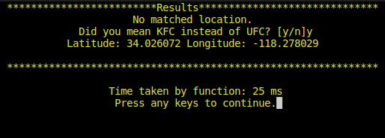
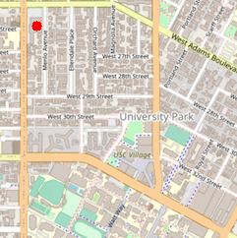
Implementing Step 2_2: Edit Distance
Check the Edit Distance between two locations (EditDistance Function)
Checks if the input location exists in the map and if not present determines if the input can be replaced with a similar named location
Considers operations like insert, delete and replacing characters
Calculates distance using dynamic programming
Time Complexity: O(n)
Fig 5. EditDistance & Finding Closest
Name Functionality

Slide 9
Implementing Step 3: Shortest Path Algorithms
CalculateShortestPath between two places using 2 Algorithms:
1. Djikstra algorithm:
Implemented using priority queue by visiting all the unvisited nodes and calculating shortest distance of the unvisited node N from the starting node
While going from the unvisited node N to another node further in the graph, it updates the neighbours
If the distance is shorter than the previous path then the updated node is pushed to the priority queue
Priority queue stores the distance value for every node using the concept of minHeap.
If a path does not exist it will return an empty vector.
Time Complexity: O(Vlog(E)) V = vertices, E = Edges in the Graph

Slide 10
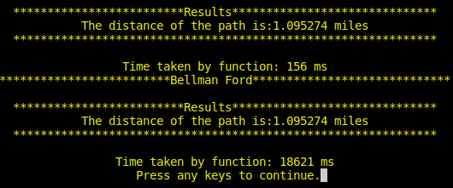
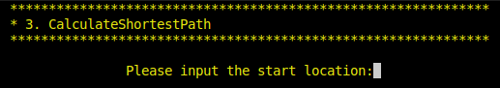
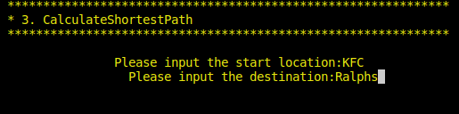
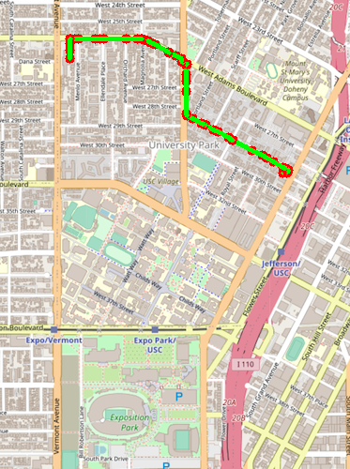
Implementing Step 3: Shortest Path Algorithms
2. Bellman Ford Algorithm:
Finds the shortest paths between two location by adding one edge at a time while finding path from a node to the starting node
It follows early termination that is the algorithm will stop when there is no changes or updates in the path
Time complexity: O(VE)
Fig 6. Shortest path using Djikstra & Bellman Ford Algorithms

Slide 11
Comparison between Dijkstra & Bellman Ford Algorithm
Dijkstra’s | Bellman Ford
Time Complexity is O(V log E ) | Time Complexity is O( V * E)
Greedy approach is taken to implement this algorithm | Dynamic Programming approach is used to implement this algorithm
Time taken: 156ms | Time taken: 18621ms

Slide 12
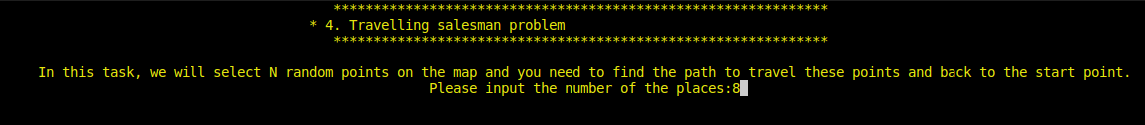
Implementing Step 4: Travelling Trojan
The Travelling Trojan Problem (AKA Travelling Salesman!)
Implements the Travelling Salesman Problem (TSP) with three approaches: Brute Force approach, Backtracking, 2-opt approaches
Algorithms aim at covering all the locations exactly once and going back to the starting point.
How these each algorithm differs is given in the following Slides.
Given a vector of location ids, assuming every location can reach all other locations in the vector.
Fig 7. Travelling Trojan UI

Slide 13
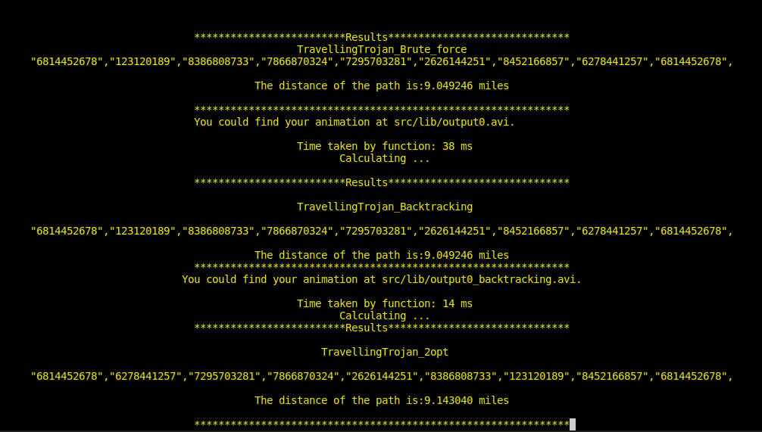
Implementing Step 4: Travelling Trojan
Fig 8. Travelling Trojan example with 8 as Input: testing using Brute Force, Backtracking, 2opt.

Slide 14
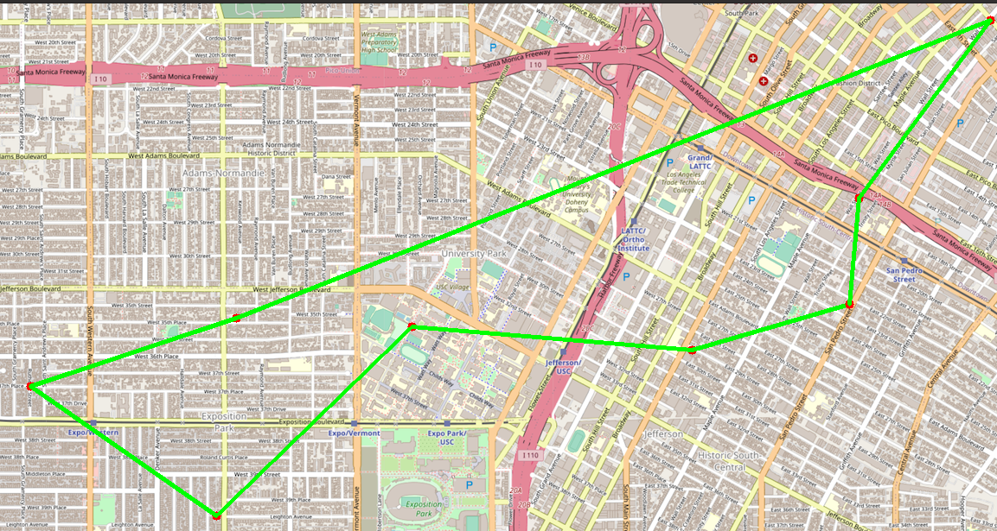
Brute Force Approach
Generates permutation and combination of each pair of nodes and returns the shortest route covering all the locations and returning back to the starting node
Time Complexity - O(n!) - n is the number of random points

Slide 15
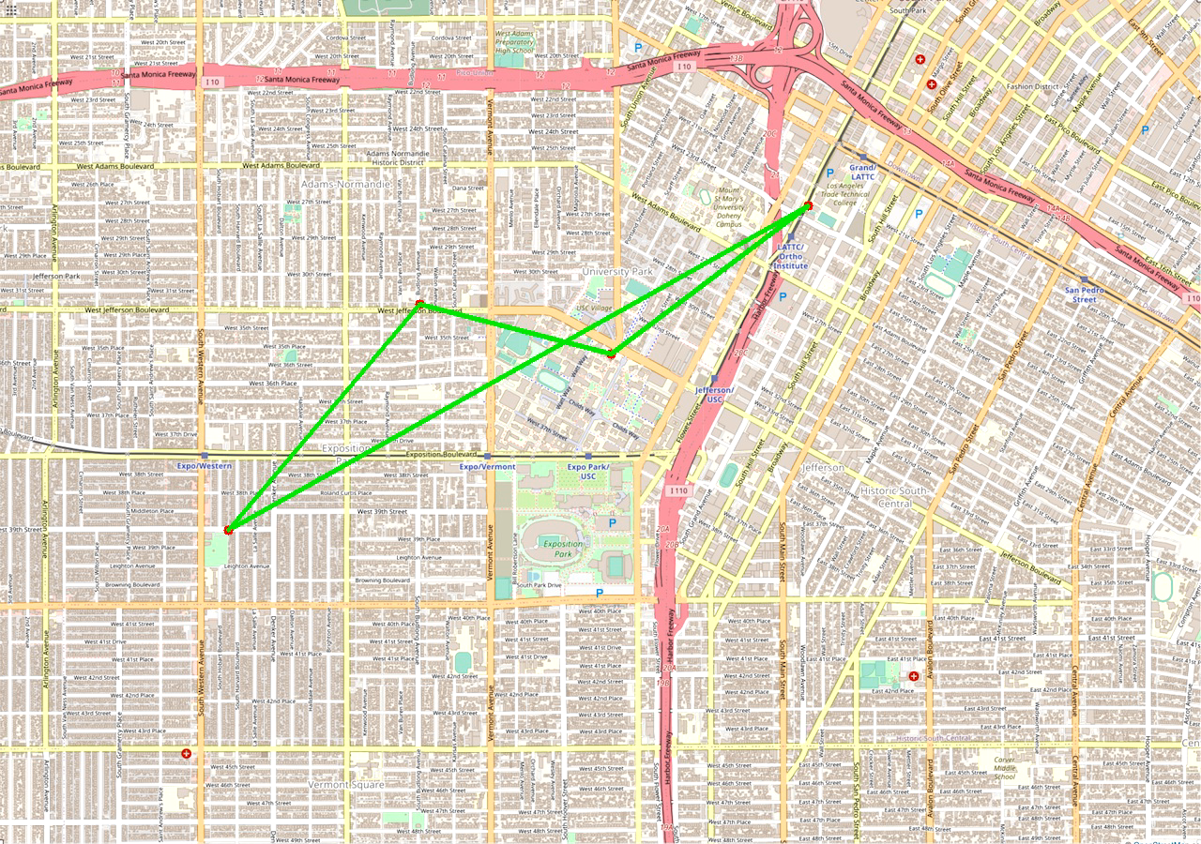
2. TSP - Backtracking Approach
Enhances the implementation with early backtracking as compared to the brute force approach.
Compares the distance of two nodes larger than the shortest route, the algorithm stops and checks for the next route

Slide 16
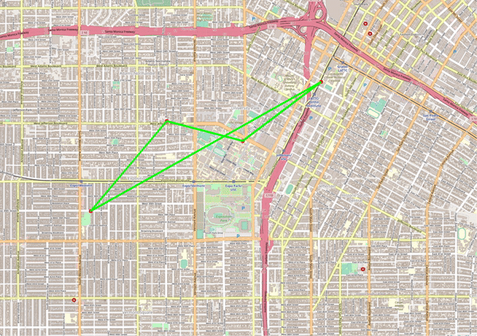
3. TSP - 2-OPT Approach
Main idea is taking a route that crosses over itself and reorder it in a way such that we do not obtain any crossovers in the route
Reverses the path between two points if the route is shorter compared to the previous one.
Time Complexity : O(N^2), where N is the number of random points

Slide 17
Comparison Between all the methods:
As observed from the results of implementing the above algorithms, 2-OPT method gives us the best feasible route in the minimal time.
The 2-opt method converges fast but can be easily trapped in local optimums
The Difference between the distances calculated was Brute: 9.049 and 2-Opt: 9.143 = 0.10
The Time Difference was: 38ms (Brute) and 14ms (Backtracking) = 24ms.

Slide 18
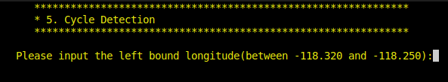
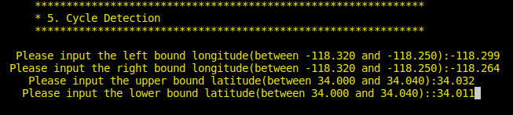
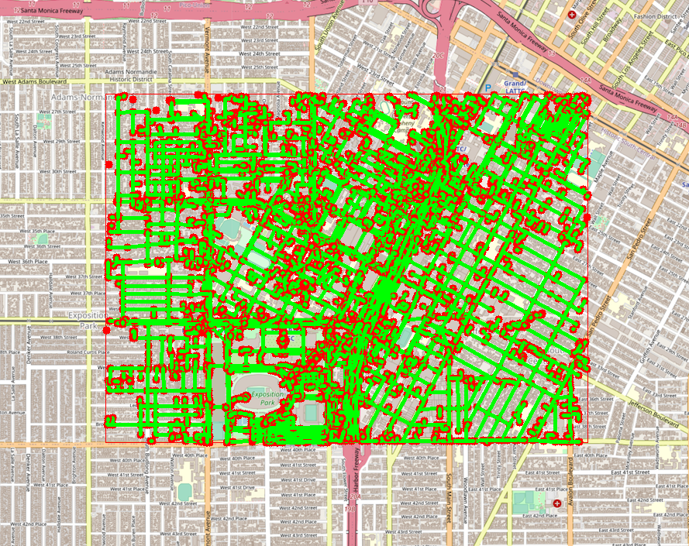
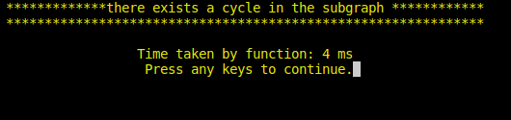
Implementing Step 5: Cycle Detection
Returns True if any cycles are present in the defined region taking into account the input latitude and longitude coordinates of the locations
Functionality implemented using DFS algorithm and unordered map.
Fig 12. Cycle detection and Insquare Implementation
The algorithms iterates over the region defined by the input coordinates and checks if the node is seen or visited and iteratively checks for any cycles detected within that region.
Time Complexity: O(V+E)

Slide 19
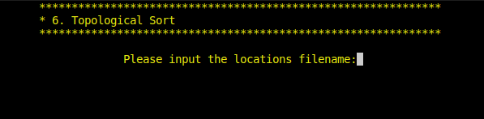
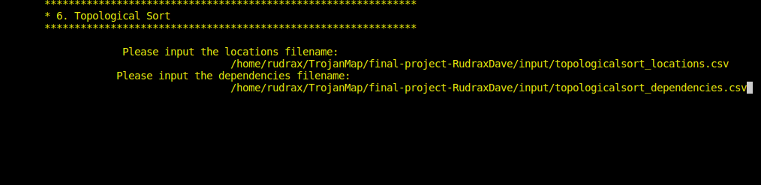
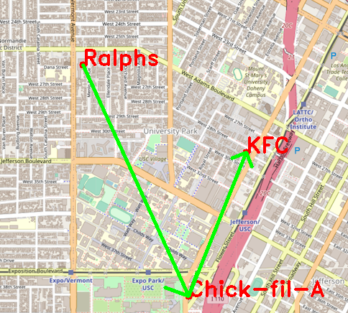
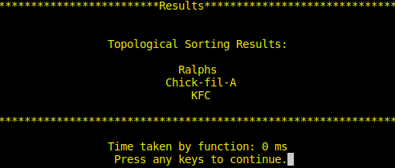
Implementing Step 6 : Topological Sort
Returns the best feasible route to travel based on the locations and their dependencies as the input
Locations from the CSV file act as nodes and the dependencies as edges.
Fig 13. Topological Sorting
Functionality creates a directed acyclic graph followed by Toplogical sort implemented using DFS algorithm
Time Complexity: O(V+E)

Slide 20
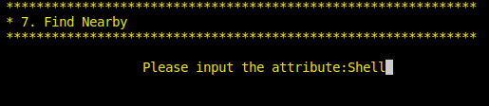
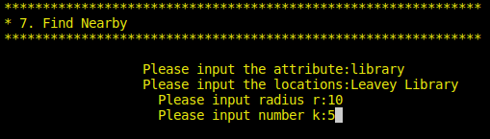
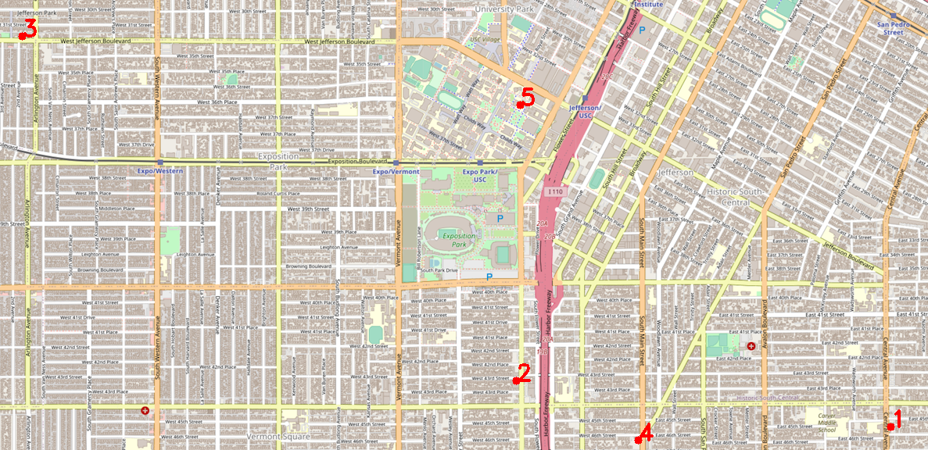
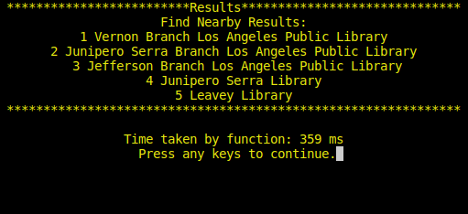
Implementing Step 7: Find Nearby
Returns a list of locations based on the attributes and the nearby input location within a particular radius from the input location
The output locations are ordered from nearest to farthest order
Fig 14. Nearby locations of Library Attribute
Time Complexity: O(mn)

Slide 21

THANK YOU
: https://github.com/ee538/final-project-RudraxDave
Linkedin: https://www.linkedin.com/in/rudrax-dave
GitHub: https://github.com/RudraxDave

